Slide 1
Title of the Project:
Automated Deployment of Azure Functions with Terraform and GitHub Actions: QR Code Generator using Python.
Khushi Agrahari
www.linkedin.com/in/khushi-agrahari05

Slide 2
Introduction
In today’s fast digital world, companies and developers prefer using serverless technology because it is easy to manage, cost-effective, and scalable. Azure Functions is Microsoft’s serverless platform that lets us run backend code without managing any server.
In this project, we created a QR Code Generator using Python. It runs as an HTTP-triggered Azure Function. When a user enters some text or a link (URL), the function generates a QR code image, stores it in Azure Storage, and gives a download link to the user.
To make the setup easier, scalable and with least manual intervention, we used Terraform, which helps us automatically create and manage all the required Azure Infrastructure services.
We also used GitHub Actions to create a CI/CD pipeline, so that whenever we update our code on GitHub, it automatically gets tested and deployed to Azure. This reduces manual mistakes and help in managing a project in more efficient way with version control.
By combining these tools, our project shows how to use DevOps, cloud automation, and serverless computing to build a modern and reliable web application or an API.

Slide 3

Objective of the Project
1) To develop a QR Code Generator using Python.
2) To build a serverless application using Azure Functions.
3) To automate cloud infrastructure provisioning using Terraform.
4) To implement Continuous Integration and Continuous Deployment using GitHub Actions.
5) To explore real-world DevOps practices and Infrastructure as Code principles.
6)To reduce human errors and manual deployment time.

Slide 4
Problem Statement
Content:
Generating QR codes manually takes time and is not useful when we need to create many codes.
Also, setting up servers to run backend code is complicated and costly. Deploying code manually can cause mistakes and takes more effort.
So, we needed a solution that:
Can generate QR codes automatically
Doesn’t need any server to manage
Deploys everything without manual work
That’s why we used Python, Azure Functions, Terraform, and GitHub Actions to build an automated and serverless QR code generator.

Slide 5



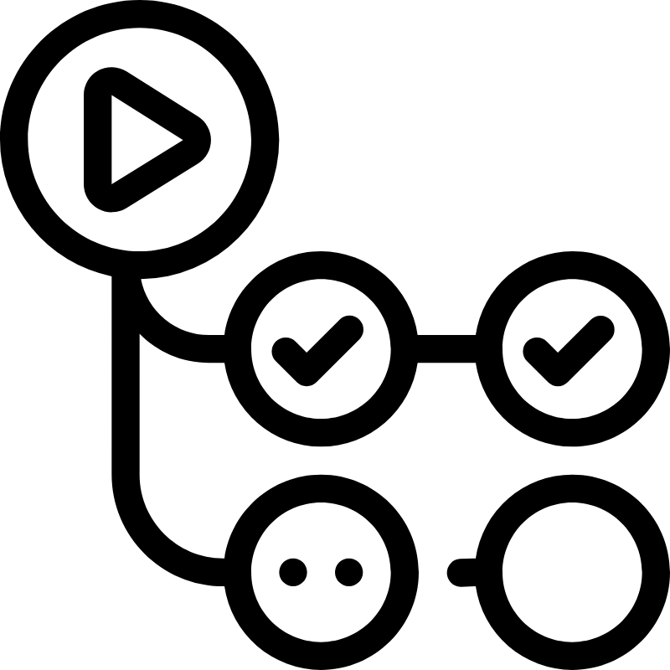
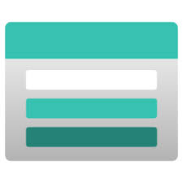
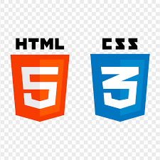
4. Terraform
Infrastructure as Code (IaC) tool
Used to create Azure resources automatically
Ensures repeatable and consistent deployments
5. GitHub Actions
Continuous Integration and Deployment (CI/CD) tool
Automates code testing and Azure deployment
Triggers workflow on every code push
6. HTML & CSS
Used to build the frontend user interface (UI)
Allows user to enter input and view QR code
Simple and responsive web layout
3. Azure Storage (Blob)
Stores QR code image files
Generates public URL for frontend access
Scalable and secure cloud storage
1. Python
Used for backend development
Created QR codes using the qrcode library
Lightweight and fast for scripting
Tools & Technologies
2. Azure Functions
Serverless computing platform
Runs Python code on HTTP trigger
No need to manage servers

Slide 6
Analysis:
QR Code Generator Module (Python): Uses Python libraries to create QR codes.
Azure Function App: Hosts the QR generator logic as a serverless function.
Terraform Automation: Automates Azure resource provisioning.
GitHub Actions Workflow: Manages CI/CD for automatic deployment to Azure.

Slide 7
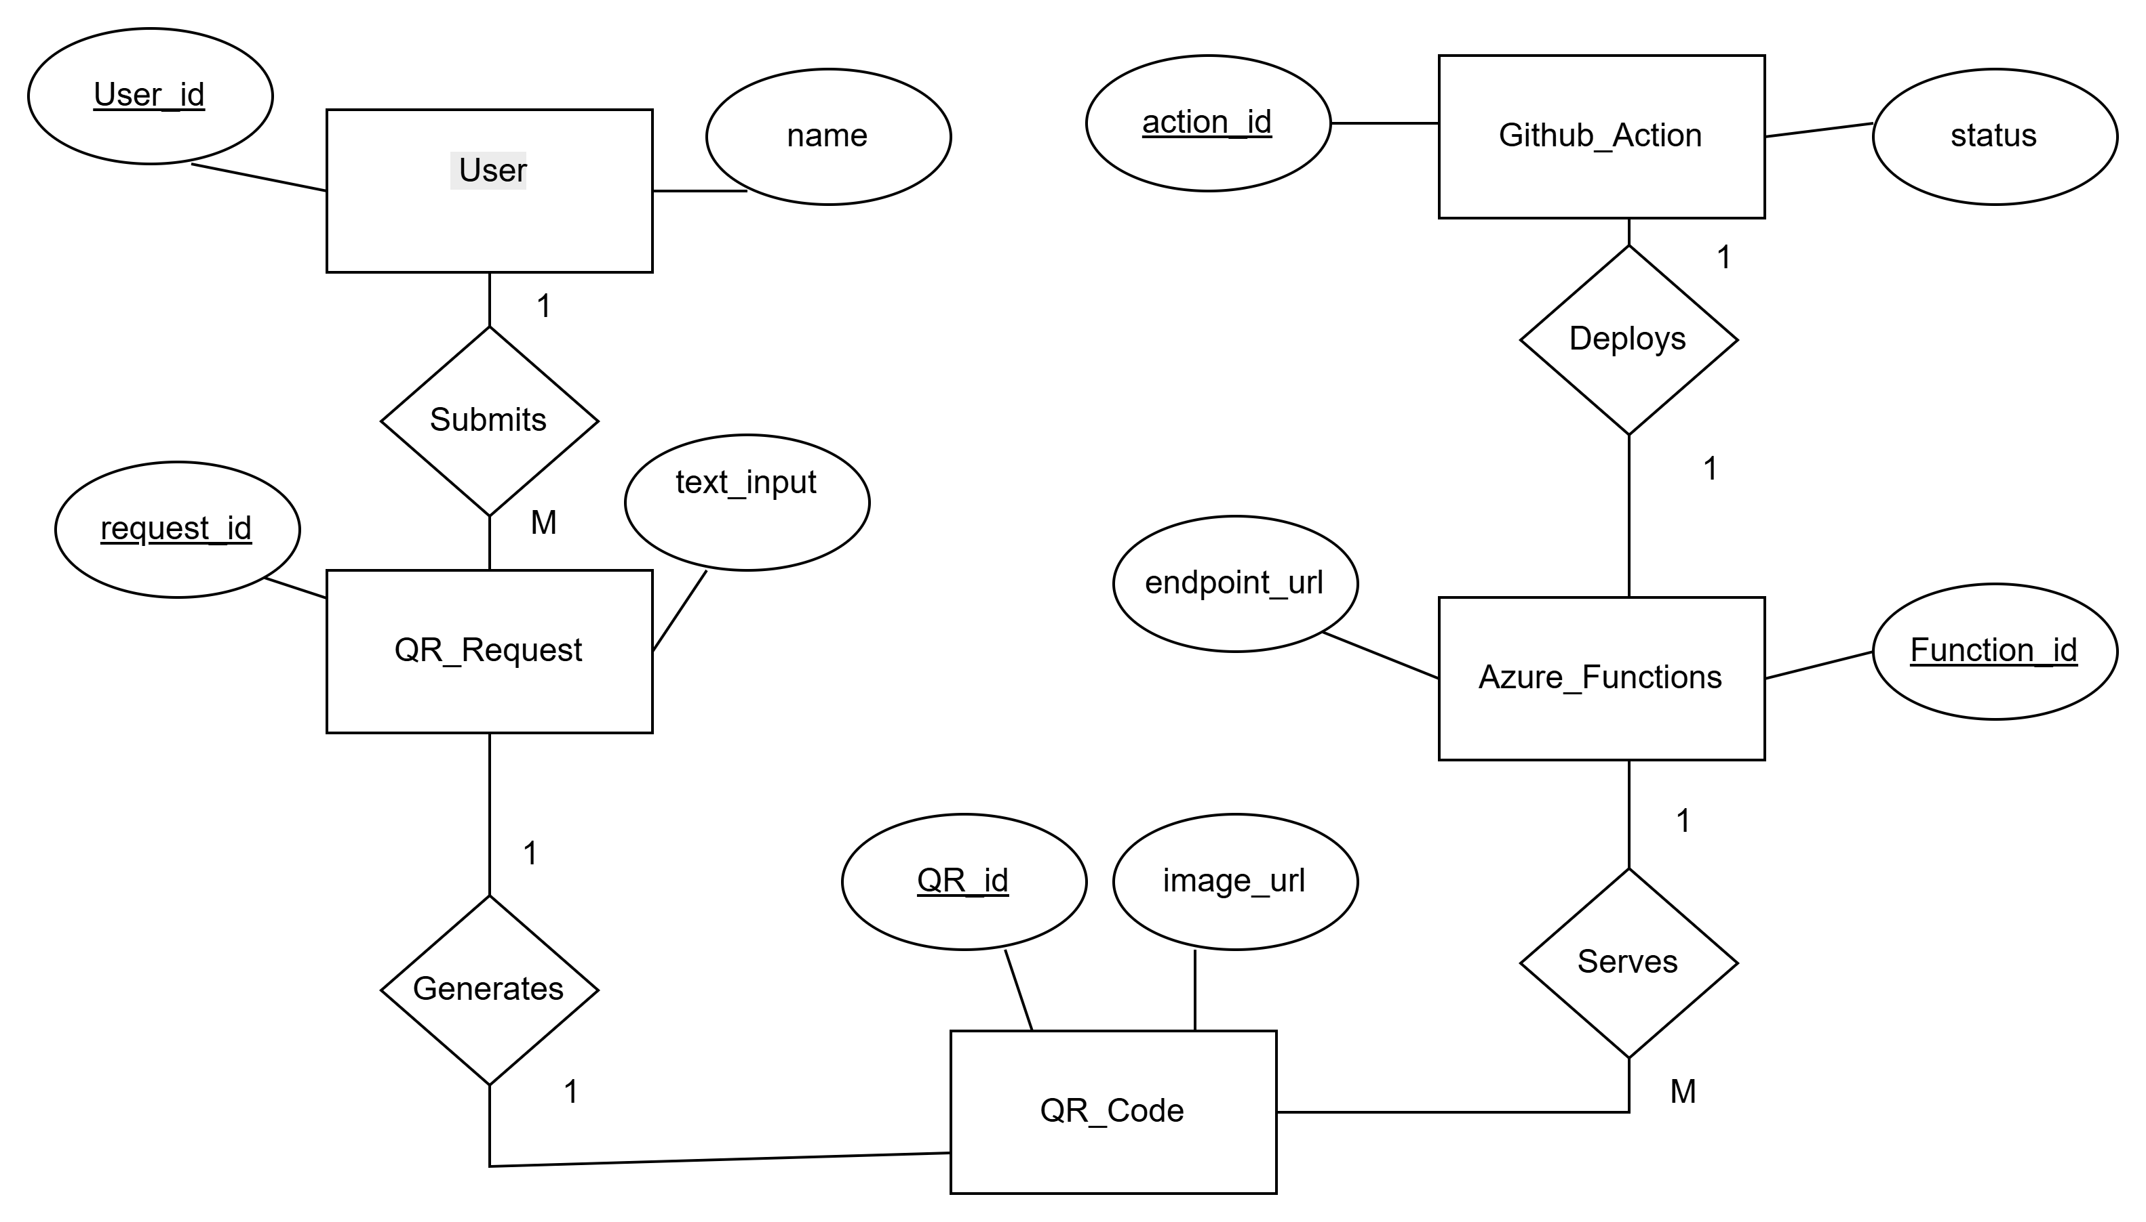
ER-DIAGRAM

Slide 8
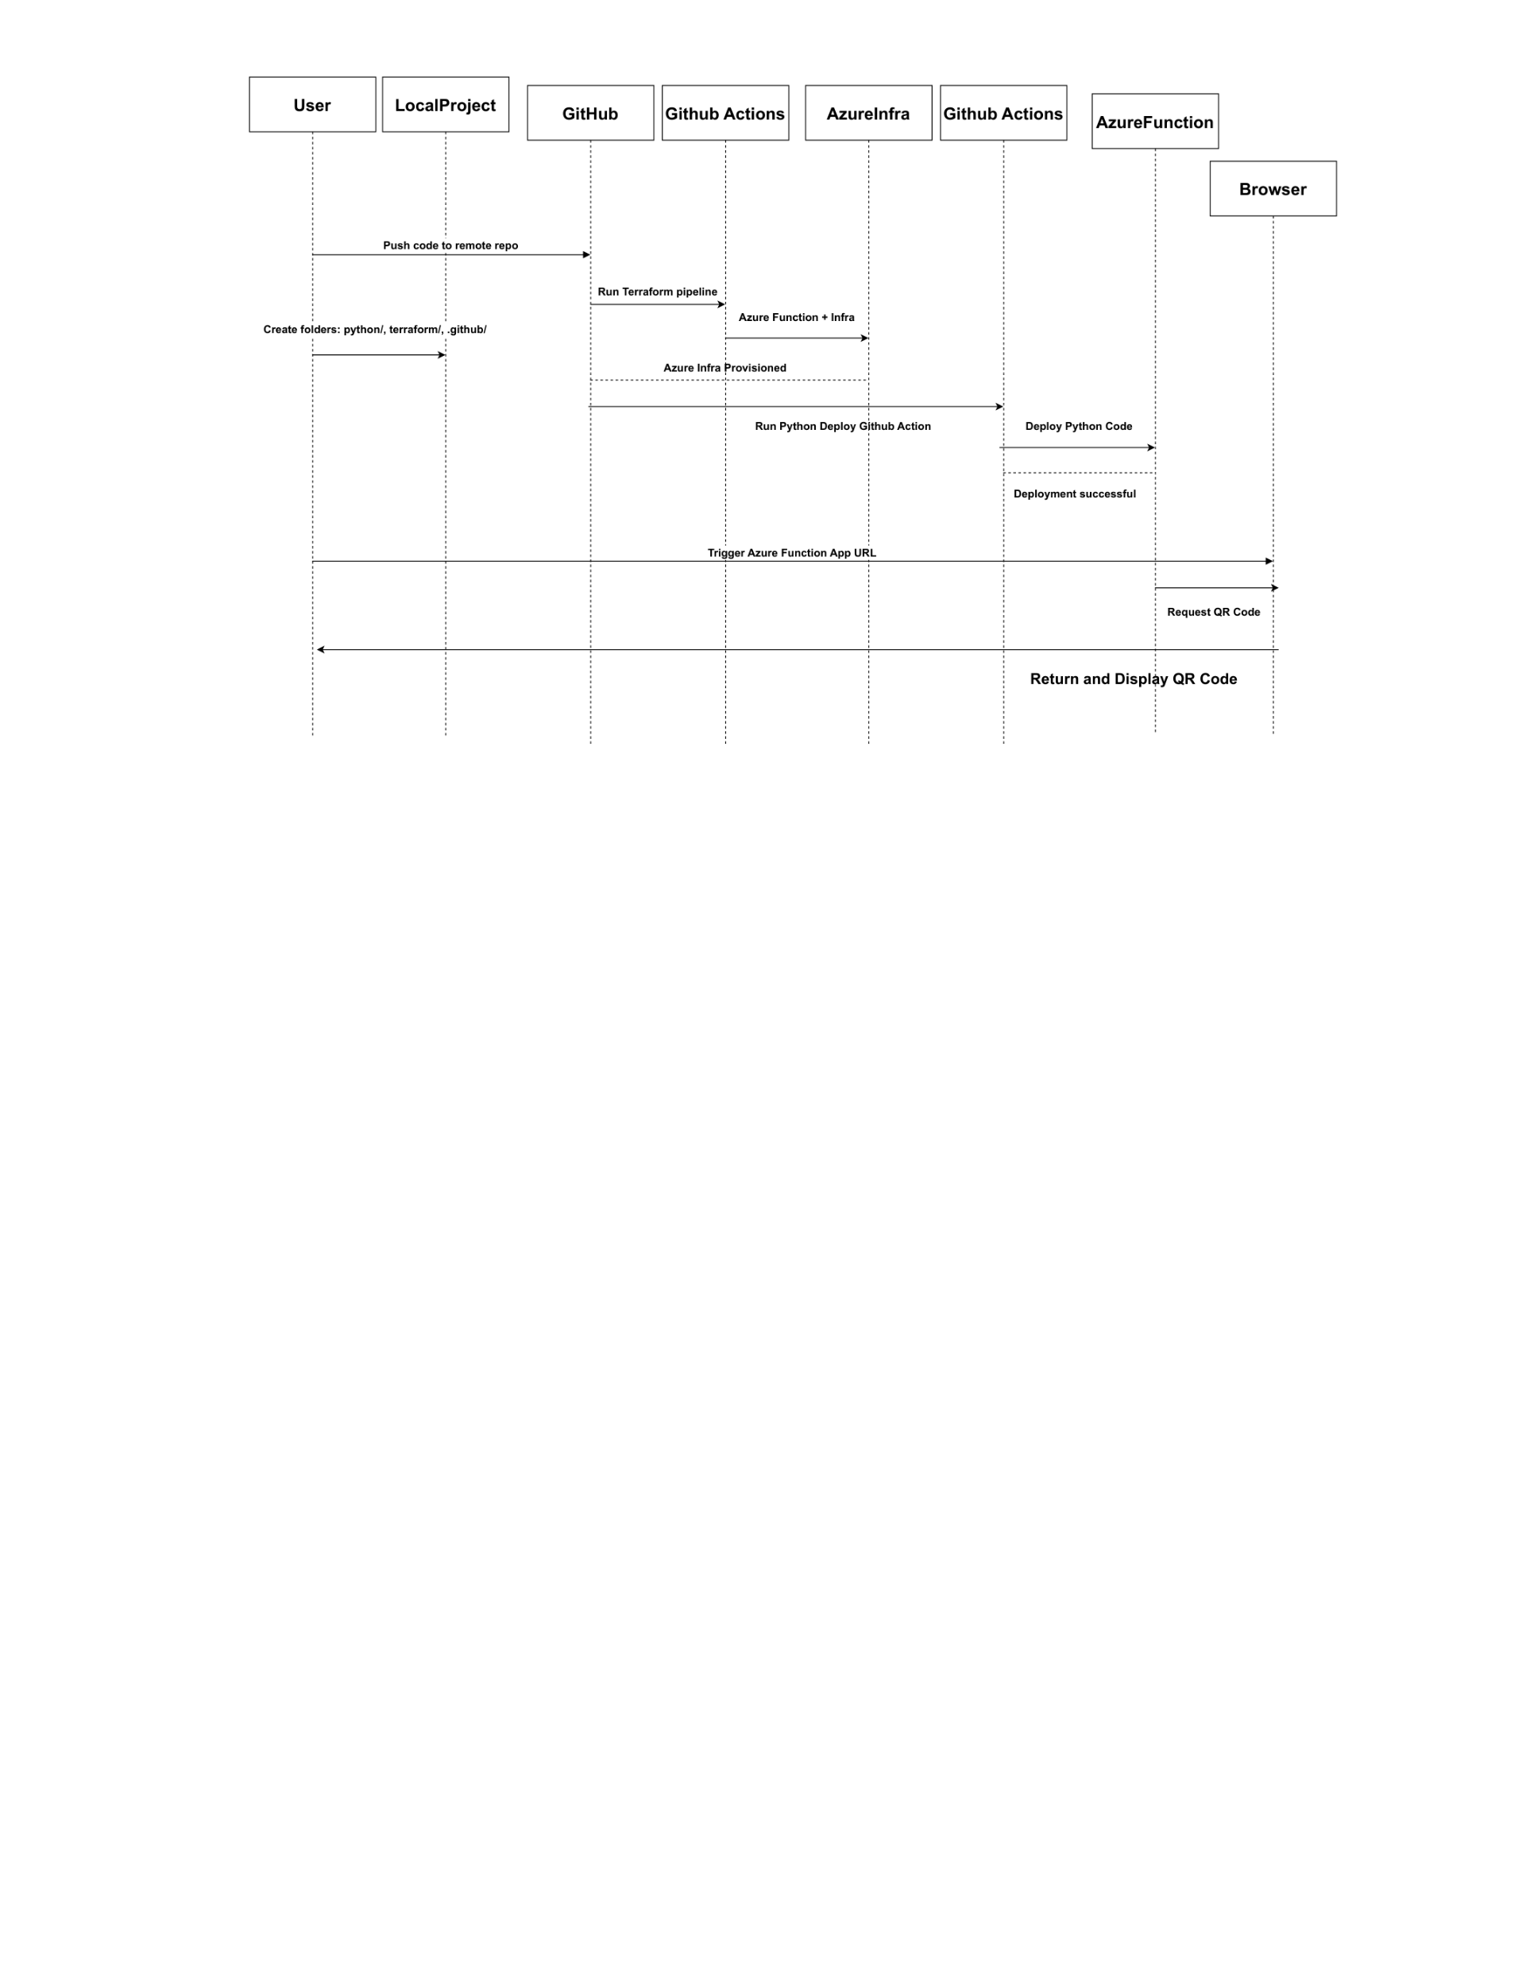
Sequence Diagram

Slide 9
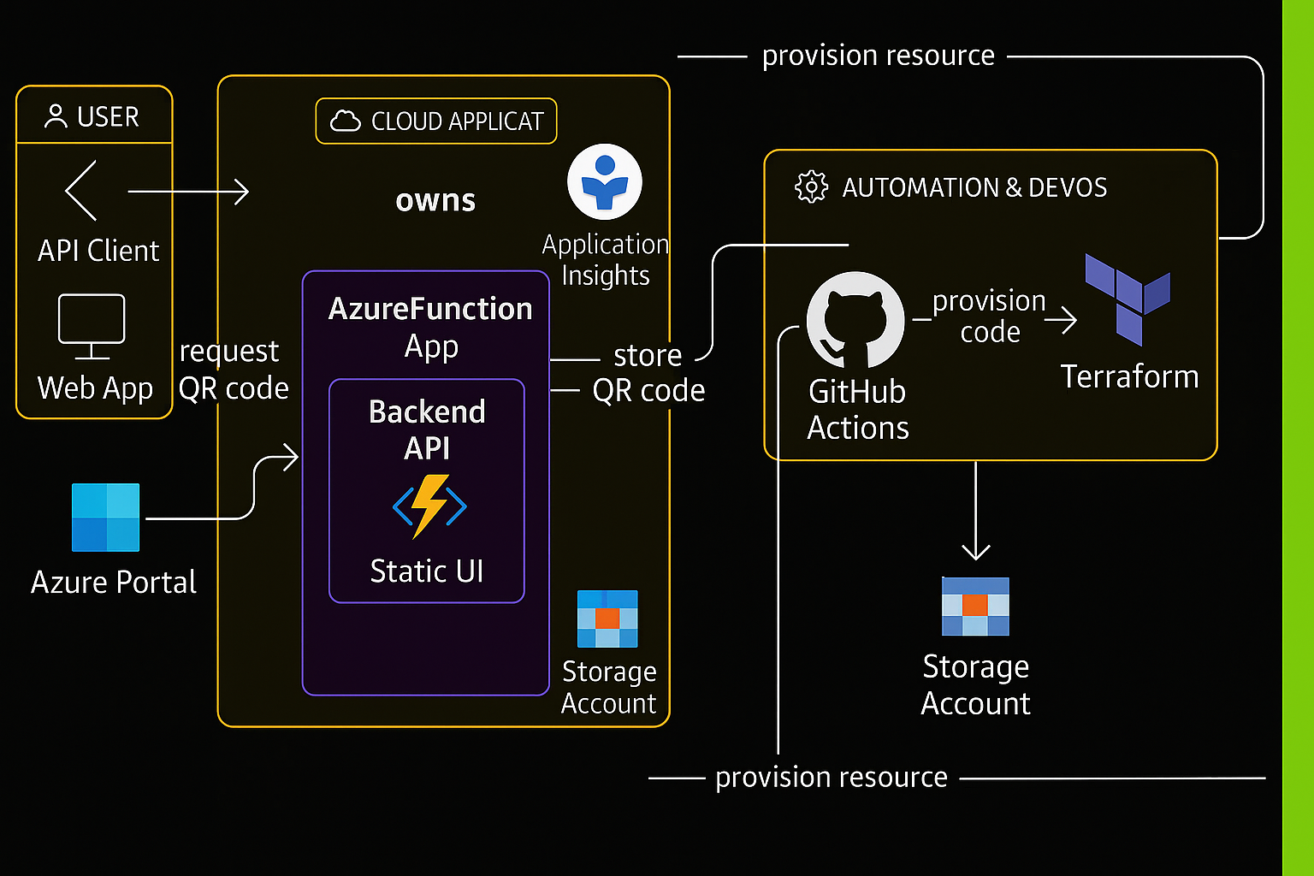

Slide 10
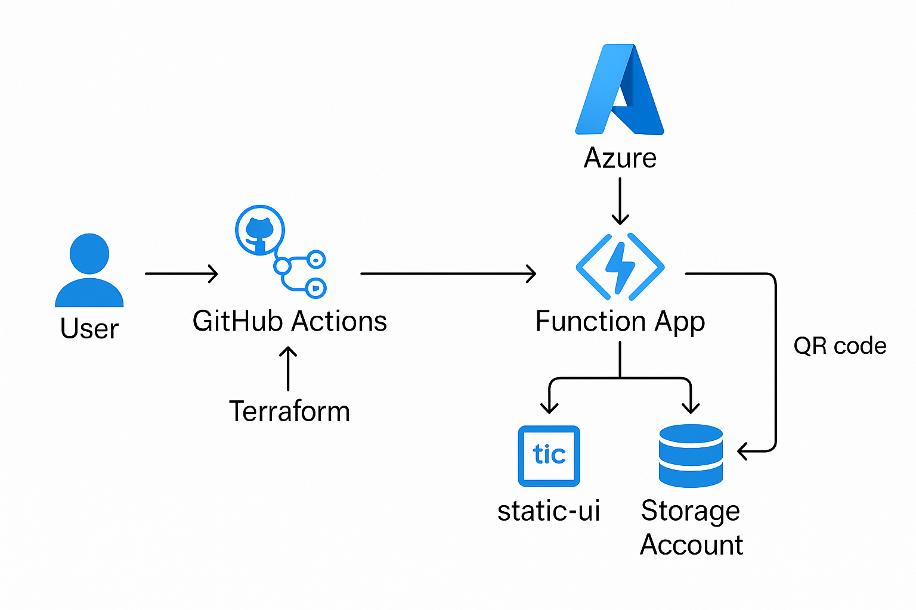
System Design / Architecture
User enters text in frontend (static-ui)
Frontend calls backend (backend-api)
Backend generates QR code and stores it in Azure
QR image is shown back to the user
Terraform deploys infra; GitHub Actions deploys the code automatically

Slide 11
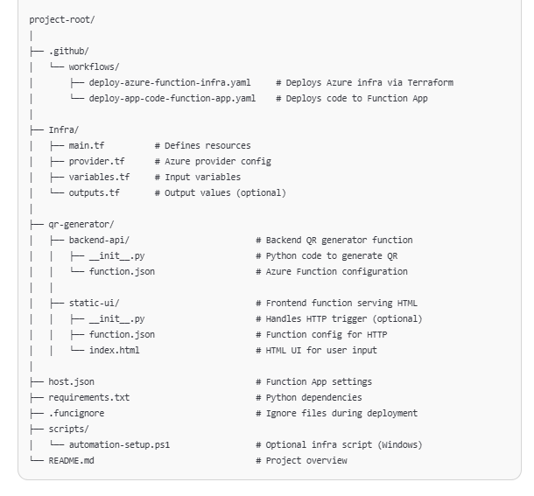
Project Folder Structure

Slide 12
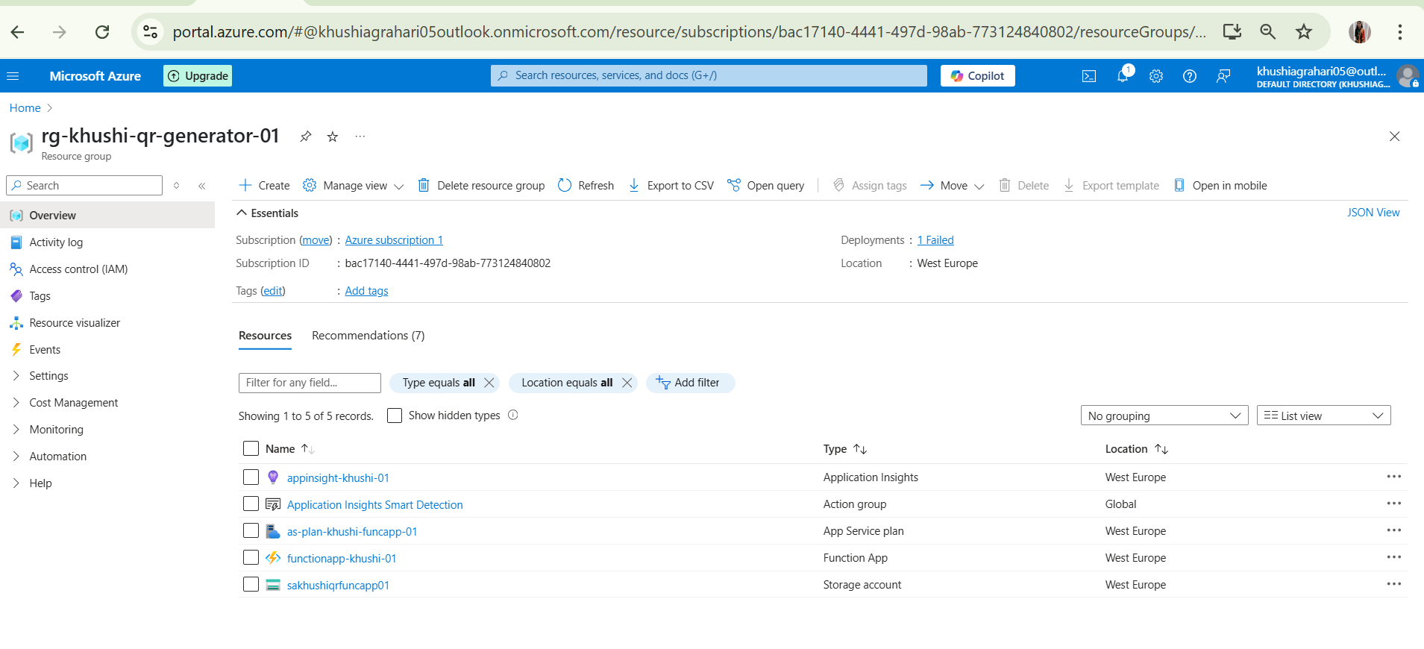

Slide 13
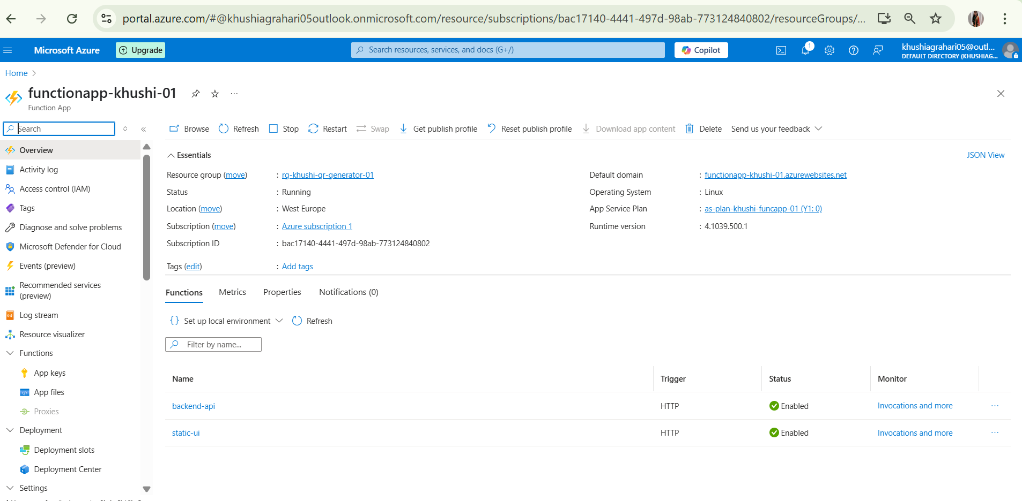

Slide 14
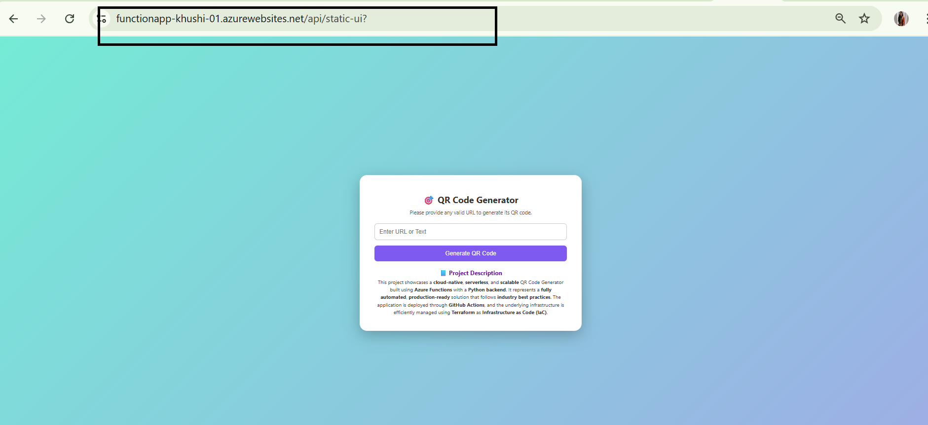
https://functionapp-khushi-01.azurewebsites.net/api/static-ui?

Slide 15
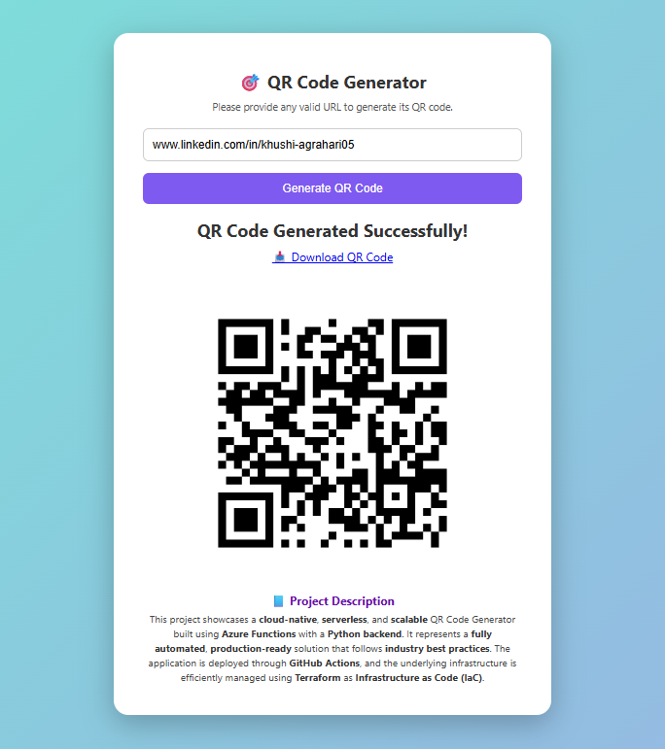

Slide 16
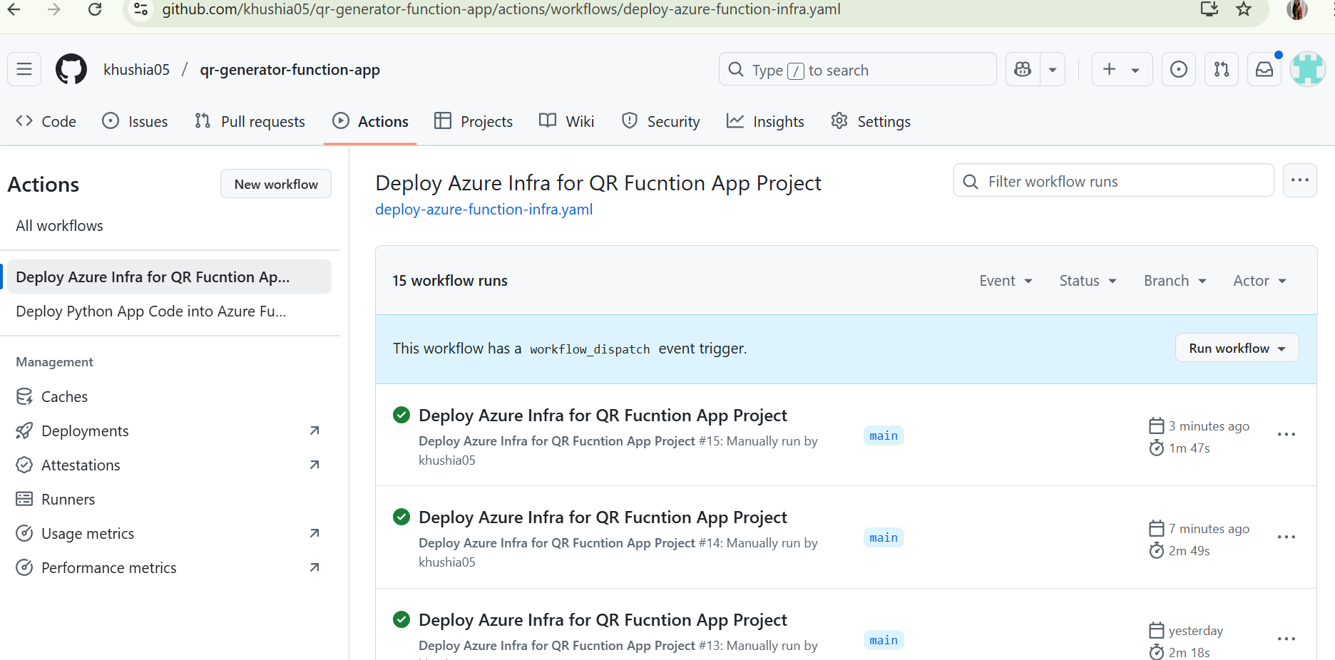

Slide 17
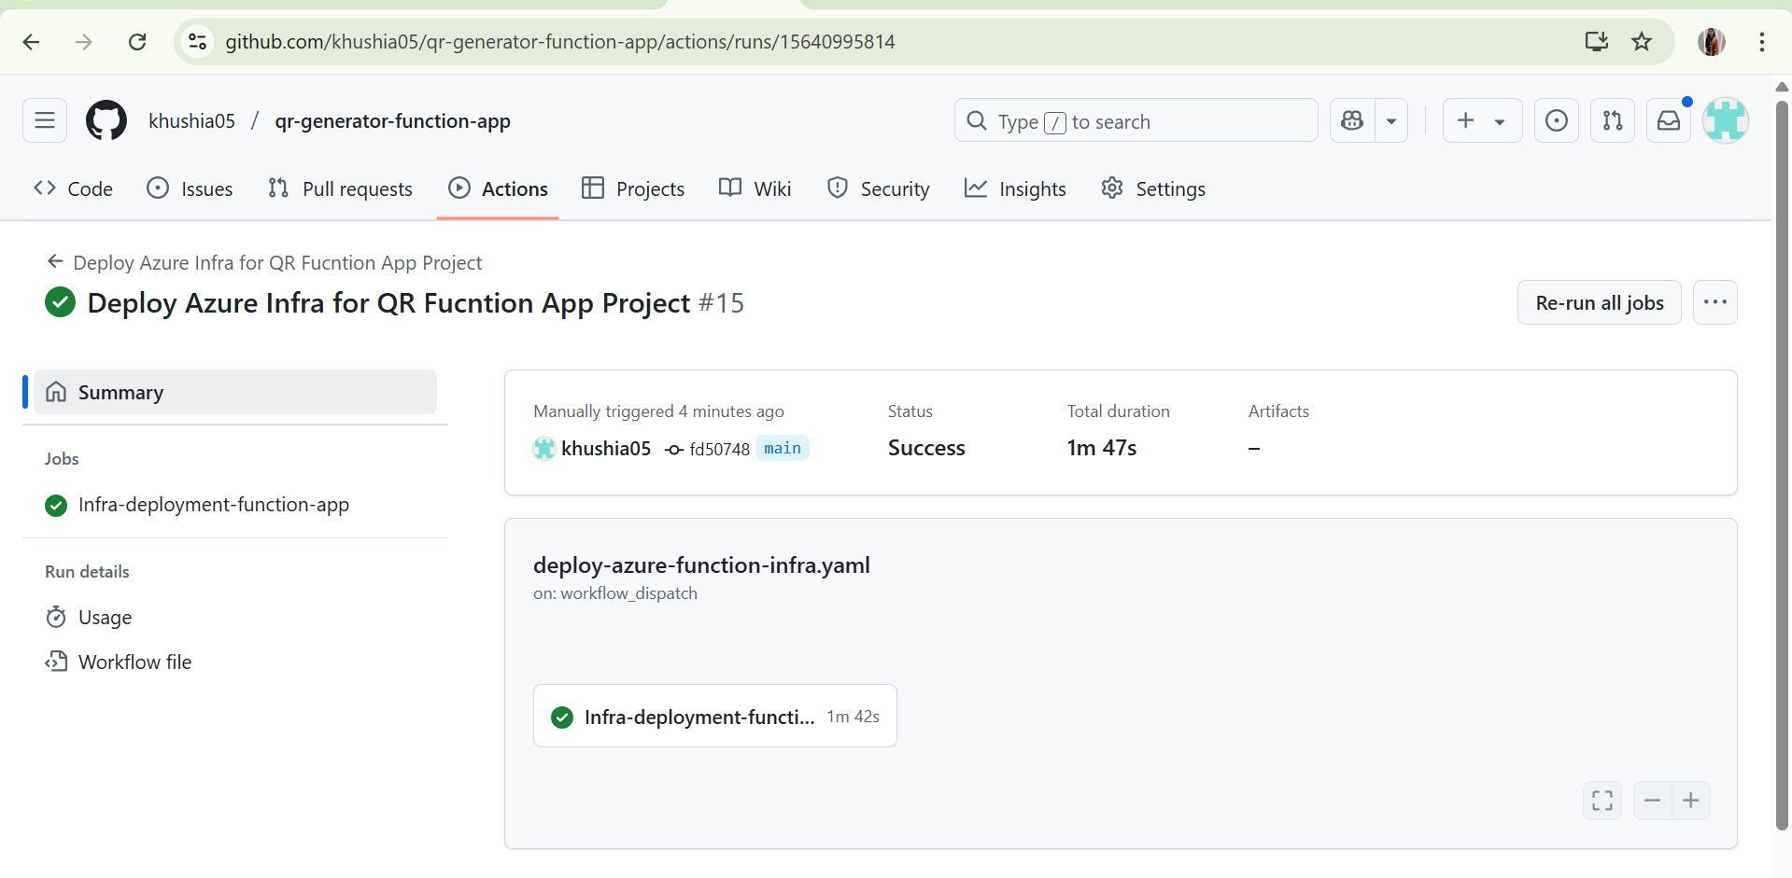

Slide 18
Advantages / Features
This project has many useful features:
Automatic Deployment: Everything is set up and deployed using GitHub Actions and Terraform. No manual work is needed.
Reusable Setup: The same infrastructure can be reused in other environments like testing or production.
Fewer Mistakes: Since it’s automated, it reduces the chance of human errors.
Real DevOps Practice: Shows how big organizations use CI/CD pipelines and cloud automation.
Cost-Effective & Scalable: It uses Azure Functions, which is a pay as you go model like any other service in Azure. It also provides quick scalibility based on the needs with couple of pricing plans including consumption plan which will only cost when function gets triggered.

Slide 19
FUTURE SCOPE
There is significant potential to enhance the project further in the future:
🗃️ Database Integration: Store previously generated QR codes along with timestamps and user info for analytics or user history.
🔐 User Authentication: Add login/signup functionality to provide personalized features like saved QR code history.
🖼️ Custom Branding: Allow users to upload a logo or customize QR code colors/styles before generation.

Slide 20
REFERENCES
The following official documentation and resources were referred to during the project:
https://learn.microsoft.com/en-us/azure/azure-functions/
https://learn.microsoft.com/en-us/azure/azure-functions/create-first-function-vs-code-python
https://developer.hashicorp.com/terraform/docs
https://docs.github.com/en/actions
Azure Free Trial Account:
https://go.microsoft.com/fwlink/?linkid=2227353&clcid=0x4009&l=en-in&icid=free-search

